Slide 1

Team: TeraByte
Members:
Prabesh Dangi
Gopal Pokhrel
Prasanna Acharya
Govinda Timsina Date: 2080 Bhadra 30-31

Slide 2
Problem Statement:
Informal middlemen in agriculture disrupt the value chain, causing financial instability for farmers, inefficiencies in distribution, and market disconnect.
Farmers need a platform that connects them directly to businesses, eliminating intermediaries, ensuring fair pricing, reducing post-harvest losses, and promoting economic growth.
The produce of the agriculture sector often are subjected to waste due to improper storage and lacking technology. So prior to such wastage of produce, they must be properly processed and send forward for packaging in order to meet the market demand.

Slide 3
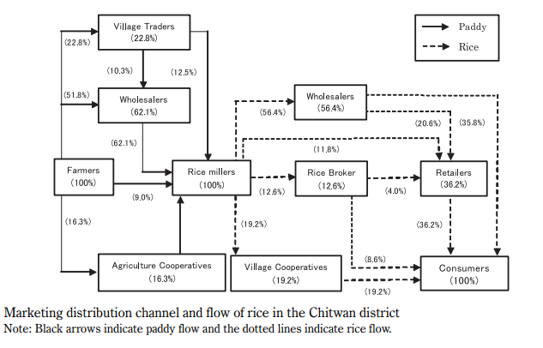

Slide 4
Overview of solution:
Agri-solution is basically focused on M2P strategy covering up the main problem of involvement of multiple stacks of middlemen in between business and farmers by providing a platform for them to directly connect with each other.
To ensure the transparency, the Agri-solution works on contract basis, dealing on the certain percentages from both parties.
Access to real-time market value of produces thus making both parties aware about the pricing.
To solve the post harvest loss, through our tool, farmers can request the concerned local body to take our products for further processing and making dry vegetables, juices and ultimately deploy them into market as packaged products.
Reduction in the import of dried veggies and mixed juices.

Slide 5
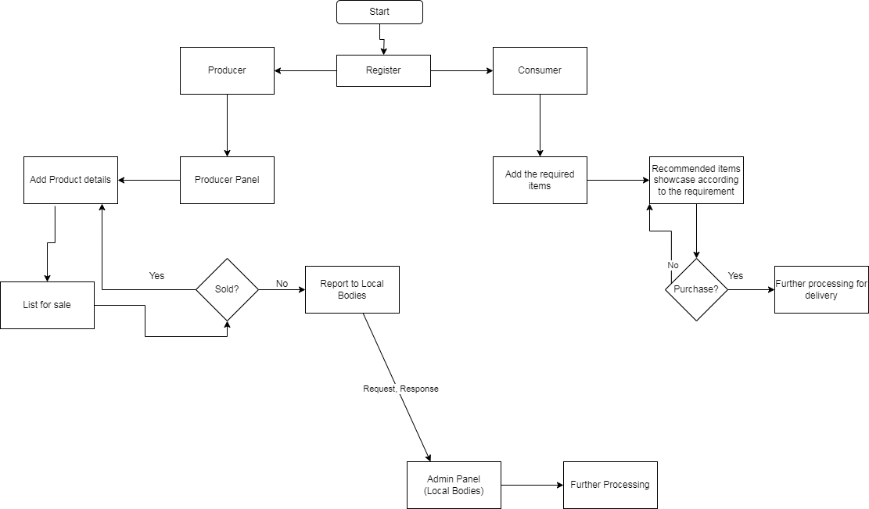
How Agro-Solution works?

Slide 6
Technical Details
Technology Used: MERN Stack
Key Feature:
Request from the producers to Local Bodies
Post harvest loss management
Reduction of multiple stacks of middlemen.
Real time Market Value

Slide 7
Impact of Agro-Solution
Artificial shortage elimination
Financial benefit to farmers
Transparency
Assistance in GDP due to reduction of import in packaged veggies to some extent.

Slide 8
Future Plans
To plan for the easy access of the platform to all the farmers
Improve UI to make it more user friendly
Include experts panel to get suggestions, expert advices to improve the relations between producers and consumers via the platform
Scale up the project to address such problem within the whole country.

Slide 9
Q&A
Any Questions?

Slide 10
Thank You!!

